Slide 1

Barton Creek Resort and Spa
Supervisor Orientation
July 20, 2012

Slide 2






Our History
Founded in 2005 at Güero’s Taco Bar on South Congress
Only organization in Texas focused on workplace English instruction
30 different sites across Austin and Central Texas including -

Slide 3
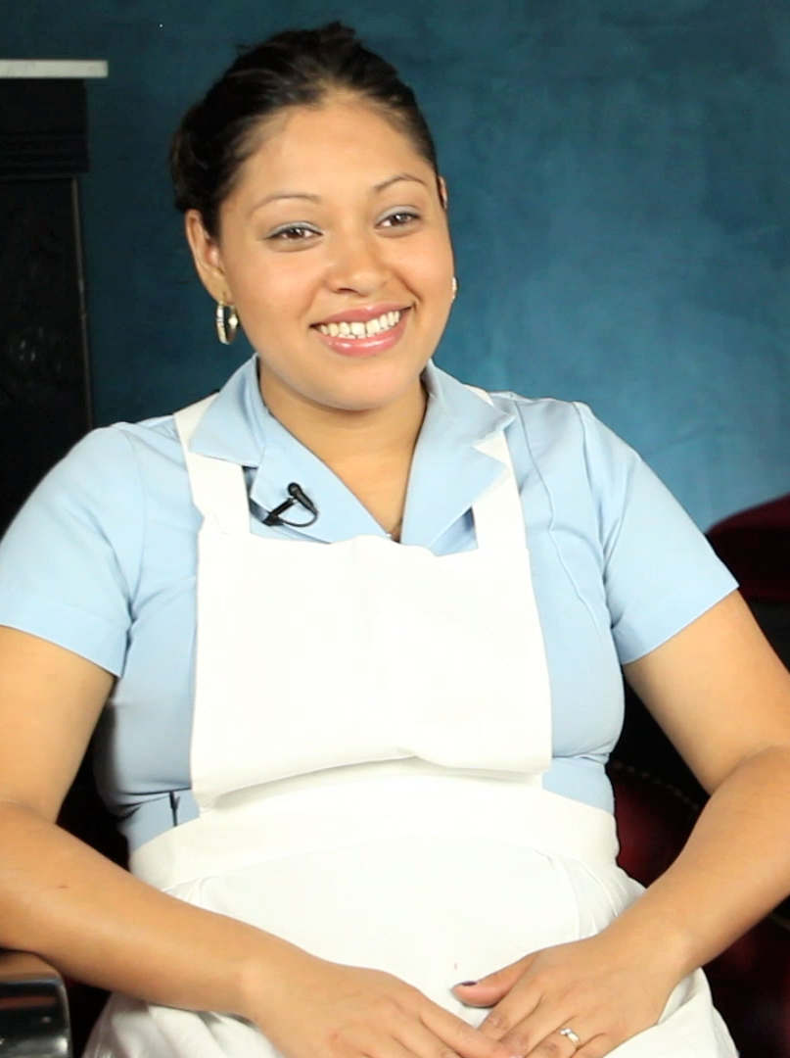
ENGLISH @ Barton Creek
OUR GOAL
To improve communication with guests, visitors, and coworkers while maintaining customer service.

Slide 4
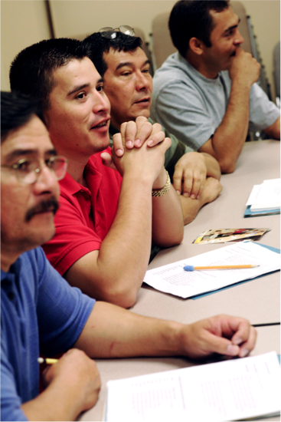
Proposed Topics
Conversations with guests/visitors
  Interactions in the room
  Bringing requested items
  Hallway interactions
  Giving directions around Barton Creek

Slide 5
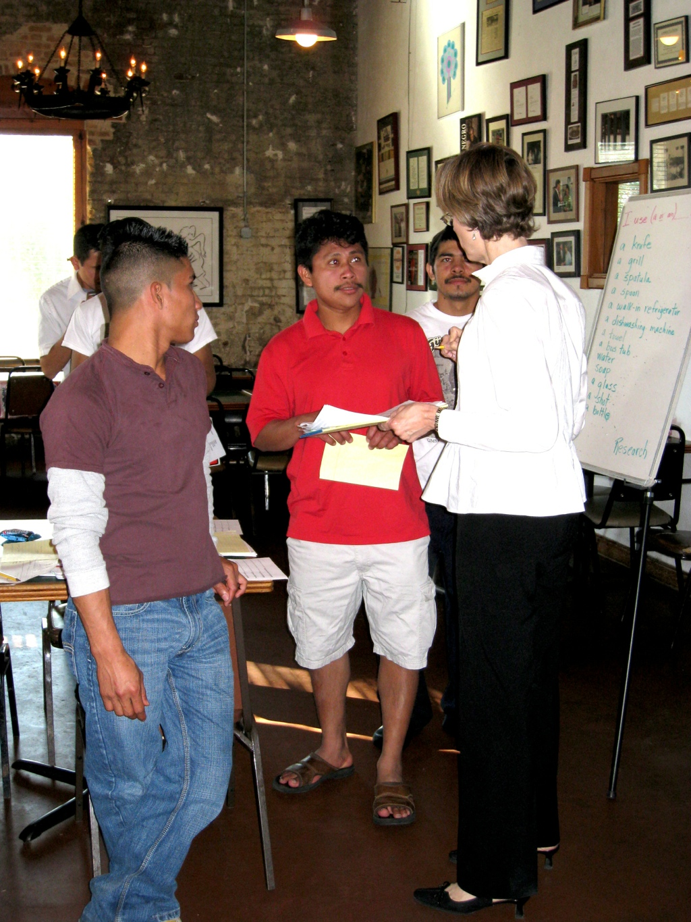
Proposed Topics
Conversations with coworkers
  Talking about the schedule
  Communicating guest needs to a coworker
  Reporting safety concerns
  Understanding instructions

Slide 6
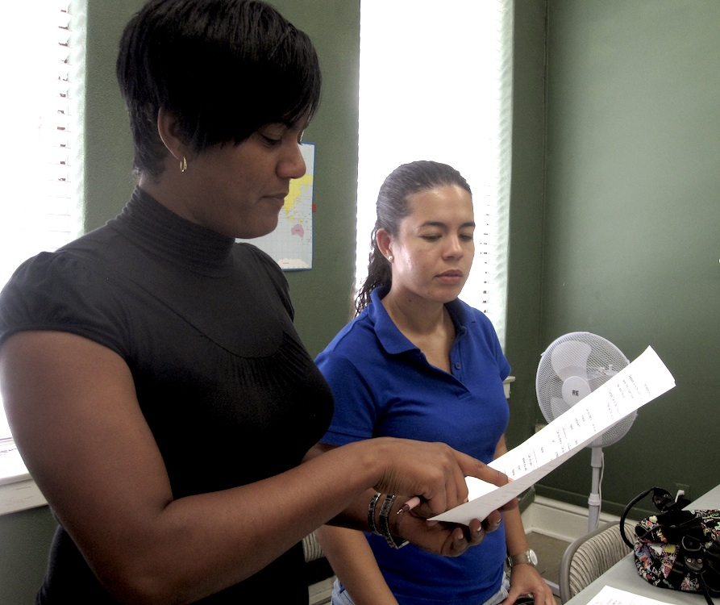
Learning English
People understand more than they can speak
Lack of confidence is the biggest barrier
Practice opportunities are critical
Some use of the native language is good

Slide 7

Logistics
1.5 hours per class
2 classes per week
Pre/post-testing & intake/outtake
12 weeks, including
  Workplace Basics
  Customer Service
  & graduation ceremony

Slide 8
Questions?
How many potential participants?
What days would be best?
What times?
Participants on the clock? ½ and ½?
Does Barton Creek have any systems that would help us gauge the impact we’ve made? (Benchmarking customer service scores)
What conversation do you want people to have at the end of the courses?

Slide 9

Marketing the Program
Who NEEDS the class?
Who is AVAILABLE?
Who WANTS to learn English?

Slide 10

Next Steps
Put up the sign-up sheet
Schedule Information Session with employees
Email/mail documents to Bekah
Put up First Day of Class sign
Remind employees 1 week and 1 day ahead

Slide 11

Action Items
ENGLISH @ WORK Barton Creek
_________________ _________________
_________________ _________________
_________________ _________________
_________________ _________________
_________________ _________________

Slide 12

Bekah Schmidt
Program Manager
512.524.5421
bekah@englishatwork.org

