Slide 1

Business Plan Presentation
November 28th, 2012

Slide 2
Why a
Business Plan?

Slide 3
Why a
Business Plan?

Slide 4
Goals
Quantify the demand for services among employers.
Identify the right price point for employers.
Optimize the sales process.

Slide 5
What Did We Do?
KLE Foundation ($16.5K)
Still Water Foundation ($10K)
Aragona Family Foundation ($10K)
Tapestry Foundation ($8K)
$44.5K

Slide 6

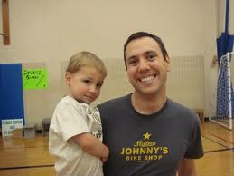


What Did We Do?
Nell Edgington, Consultant
KLE Foundation ($16.5K)
Still Water Foundation ($10K)
Aragona Family Foundation ($8.5K)
Tapestry Foundation ($8K)
$43K
Advisory Committee
Market Research
Jocelyn, Part-Time Sales

Slide 7
Takeaways from Market Research
How to prioritize industries
  Grocery
  Health Care
  Hospitality

Slide 8
Takeaways from Market Research
How to prioritize industries
Mitigate price sensitivity
  Grocery and Health Care less sensitive
  Hospitality extremely sensitive

Slide 9
Takeaways from Market Research
How to prioritize industries
Mitigate price sensitivity
Demand for services is low in a “cold” market
  Pull marketing
  Network hubs

Slide 10
Takeaways from Market Research
How to prioritize industries
Mitigate price sensitivity
Demand for services is low in a “cold” market
Make a value-driven argument

Slide 11
The Pivot
 | BEFORE | AFTER
Industry Prioritization | Health Care Hospitality Grocery | Grocery Health Care Hospitality
Business Pitch | “E@W can give you a competitive advantage.” | “E@W can reduce costs and increase revenue. For example, Seton estimates E@W saved them $250K over 3 years.”
Business Conversion Rate | 30:1 | 24:1 (with part-time salesperson)

Slide 12
The Pivot
 | BEFORE | AFTER
Number of Product Lines | 1 | 3-5
Service Model | 6-month course sequence | Business chooses which course(s) to provide Small group tutoring available Customized training [Certification classes] [Native Language Workshops]
Revenue per Course | $700 | $1,600

Slide 13
The Plan
Hire a full-time salesperson

Slide 14
The Plan
Hire a full-time salesperson
Diversify workplace services.
  Tutoring
  Certification courses
  Training in native language

Slide 15
The Plan
Hire a full-time salesperson
Diversify workplace services.
Increase revenue per course to $5,000 by 2015.
Notes:
$5,000 per course would make E@W the first literacy program that pays for itself
Average price of new courses sold:

Slide 16
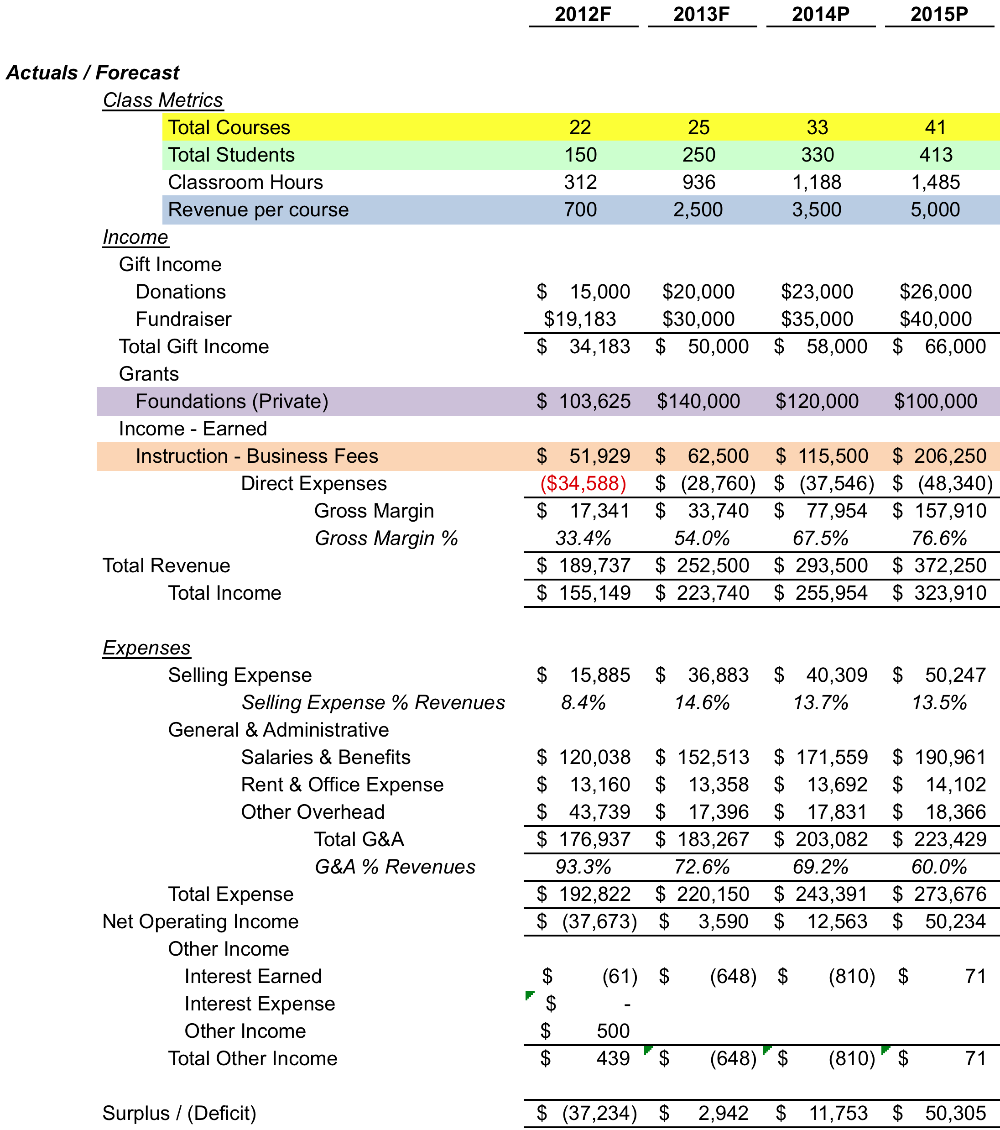
Financials
Notes:
Point out:
Student numbers more conservative
revenue per course → decreased dependence on foundation grants

Slide 17
The Need:
Strong Foundation Support
2013 | 2014 | 2015 | 2016 | 2017 | 2018
$140,000 | $120,000 | $100,000 | $50,000 | $25,000 | $10,000

Slide 18
Questions

